Slide 1
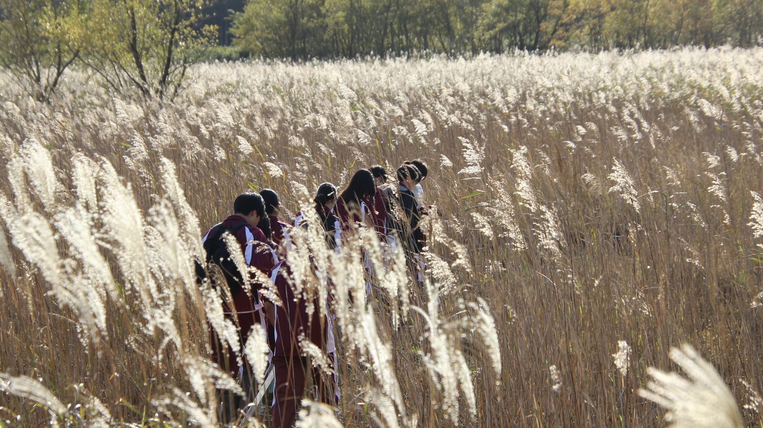
Water quality survey
Kosaka
Hamamura
Fuzimoto
Miyake

Slide 2
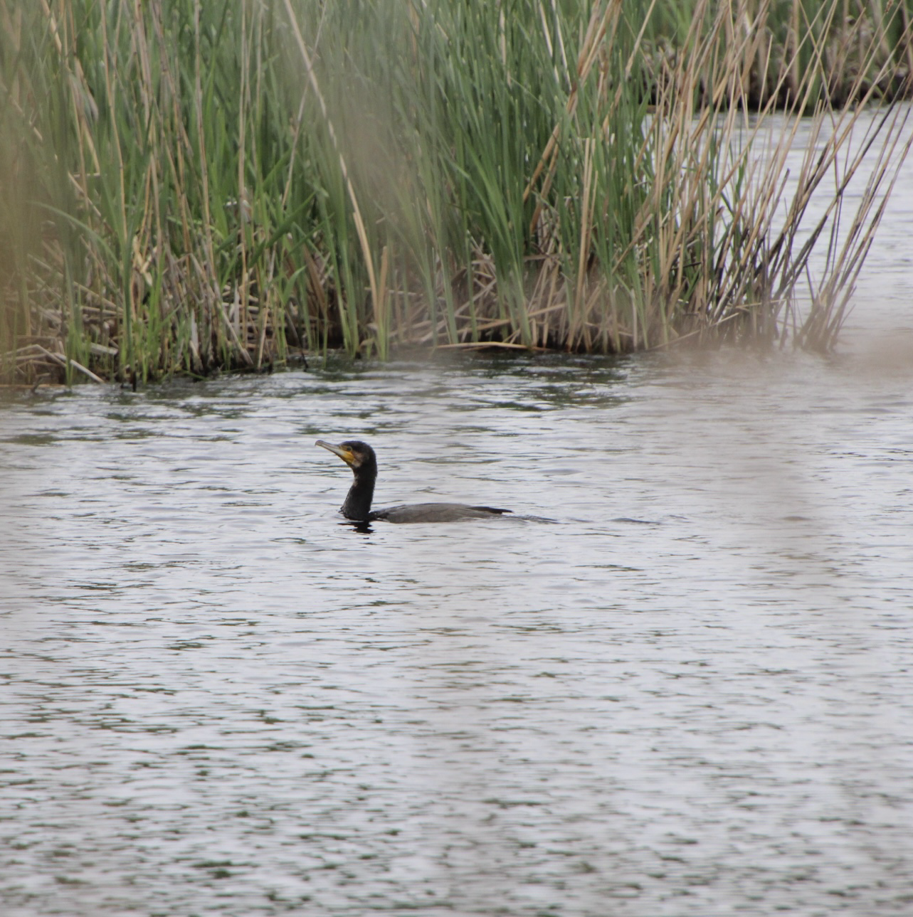
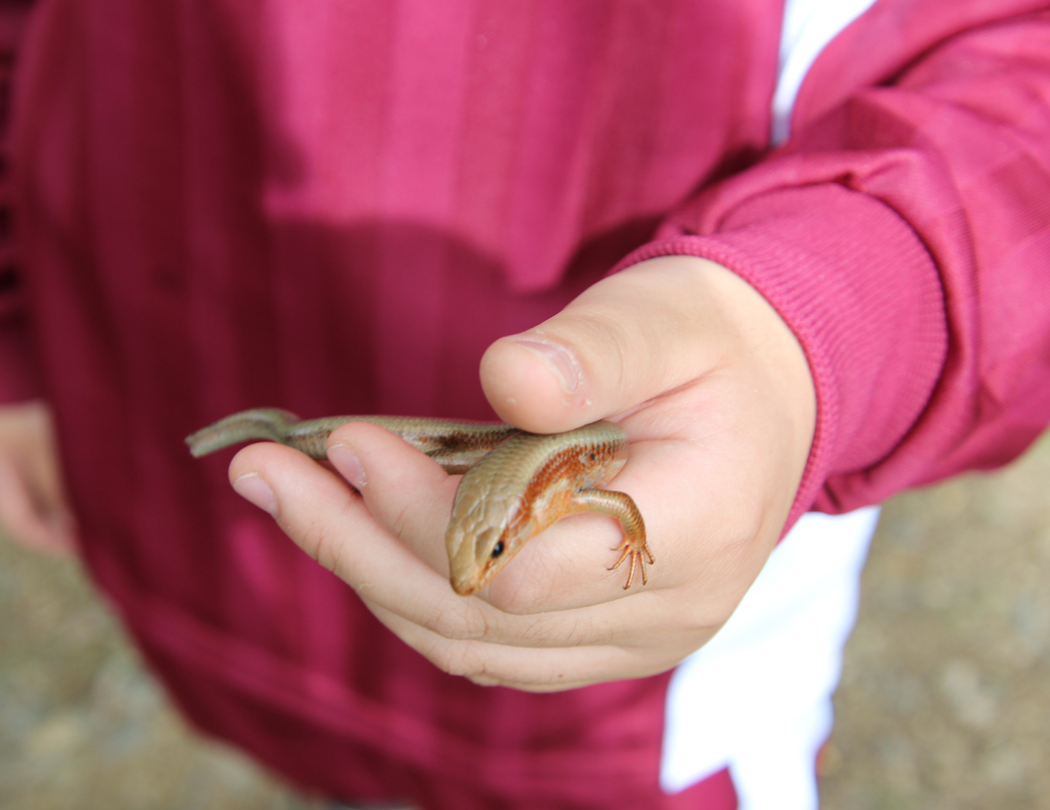
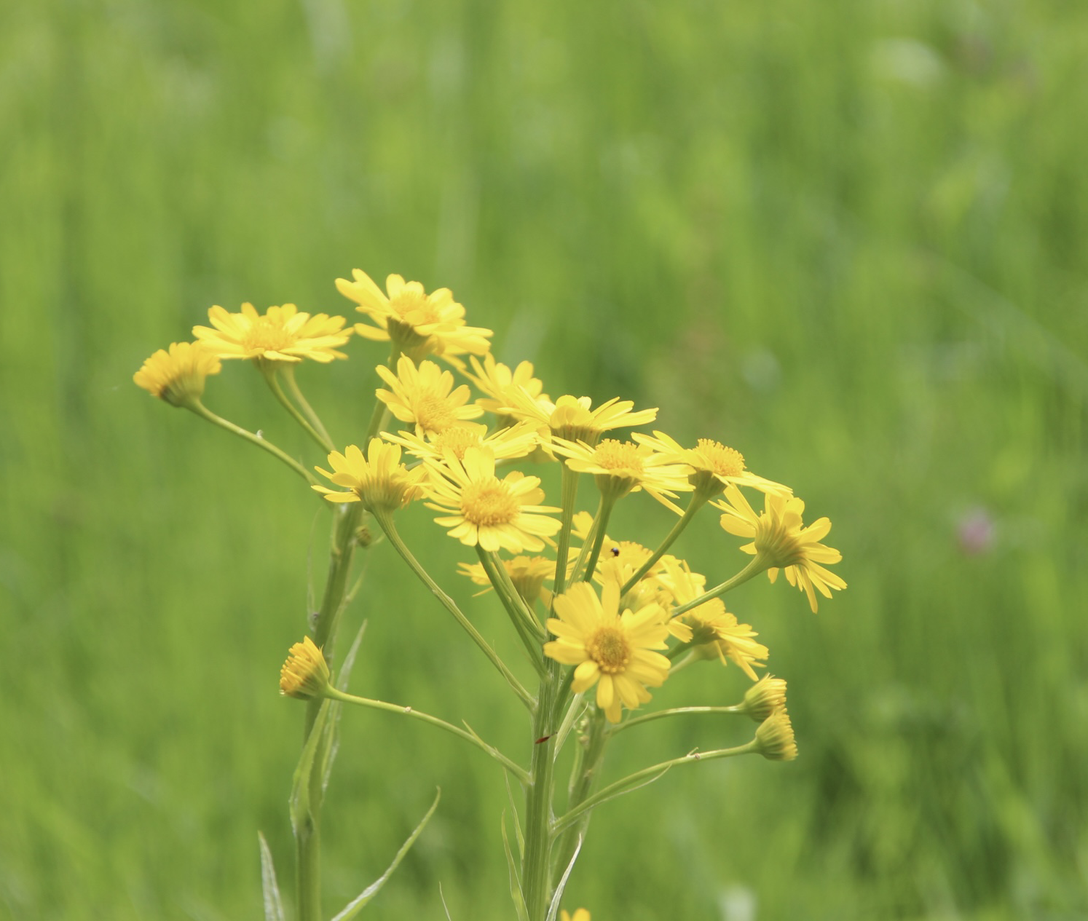
First of all
Nakaikemi is a wetland surrounded by three mountains
It is a very natural place

Slide 3
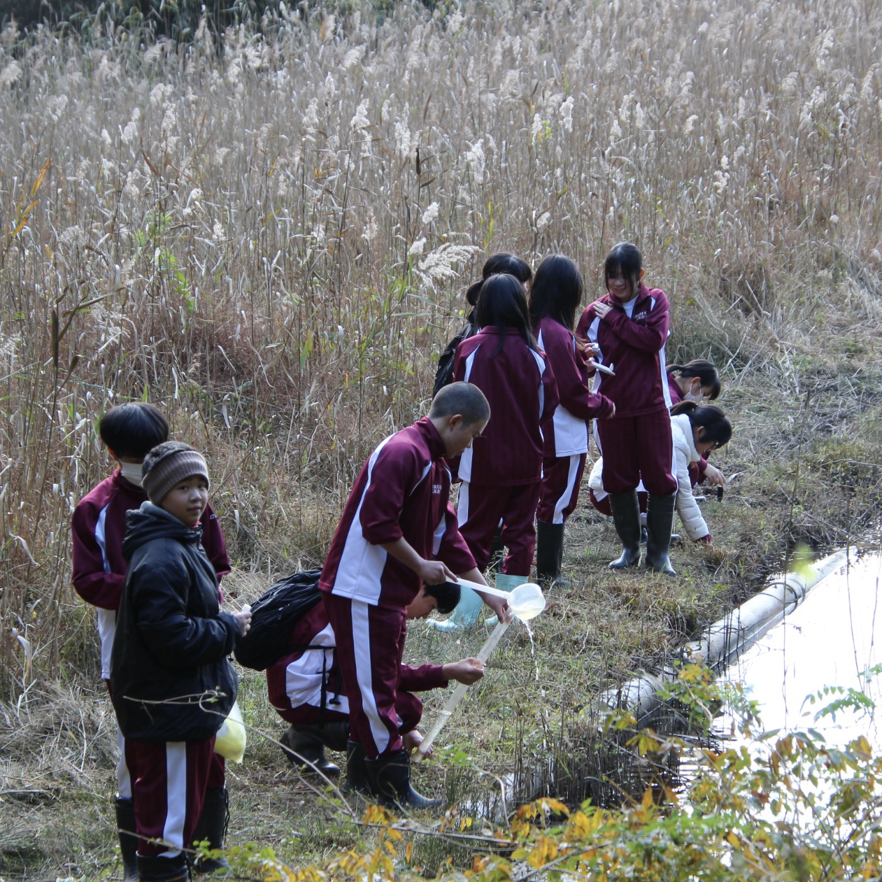
Purpose of activity
We were interested in whether it was different from past data
To know the reason for the difference in data

Slide 4
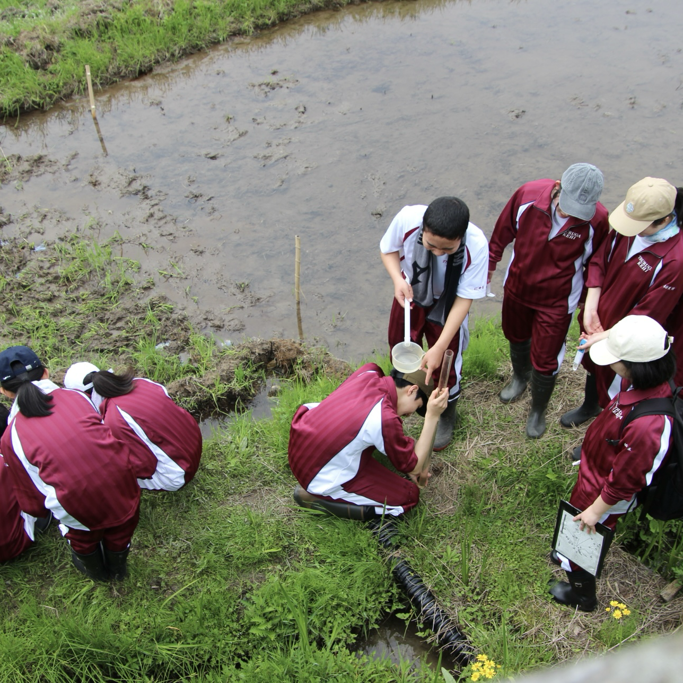
How to do activities
Go to Nakaikemi and get water from several places
Submit it to the Energy Research Center for investigation

Slide 5
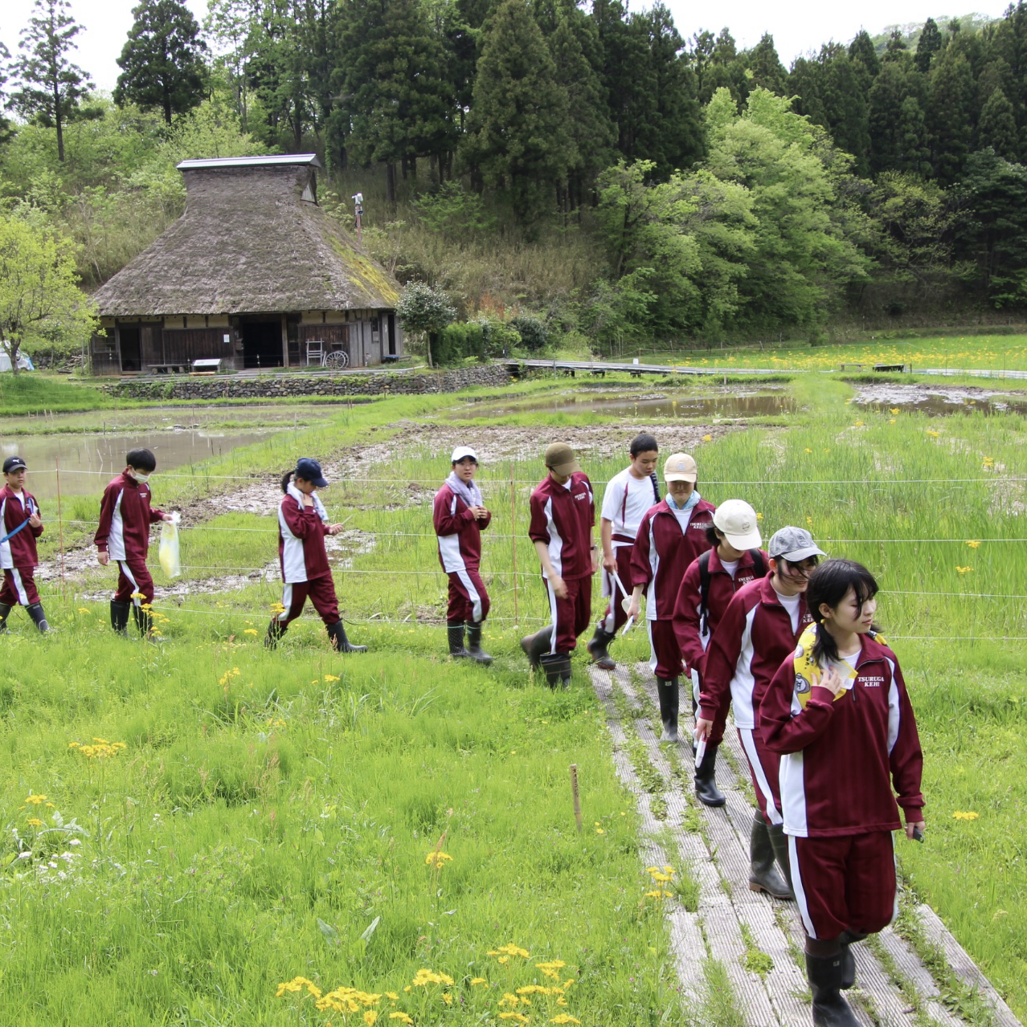
Feedback
There were many unfamiliar tasks such as summarizing data and making tables, which was difficult.
It was fun to survey with my friends while feeling the four seasons by surveying 4 times a year.

